Slide 1


POWER BI PROJECT PRESENTATION
Toy Store E-Commerce
Sales Dashboard
Tools: SQL Server & Power BI Duration: 5th June - 5th August 2026 Team Members: Arpita, Debanjan, Puja, Rakhi, Riya, Rohit, Sayan, Siuli, Subham, Tanushree, Tushar

Slide 2






Agenda
Project Overview
Data Preparation
Objectives, tools & technology stack
Cleaning & validation performed in SSMS
Data Model
Report Pages
Source tables and the 36-measure catalog
Purpose & content of all 7 pages
Technical Notes
Filters & Interactivity
File details & documentation limitations
19 slicers driving self-service analysis

Slide 3
1. Project Overview
An end-to-end analytics solution for an e-commerce toys business, covering sales performance, product & inventory analysis, customer behaviour, transaction detail, and website traffic and traffic conversion, sourced from SQL Server and delivered in Power BI across multiple pages and visuals.
7
60
42
6
Report
Pages
Total
Visuals
DAX
Measures
Source
Tables
OBJECTIVES
Give the top management a view of revenue, profit, orders & customer KPIs at a glance.
Tools & Technology
Break down performance by product for data-driven merchandising decisions.
SQL Server: Data Processing- checking for NULL values, outliers. Power BI Desktop: Data modelling, DAX measures, Visualisations.
Understand customer segments, like new vs repeat, at risk vs active.
Provide transaction and website session level detail for operational analysis.
Support self-service exploration via consistent slicers on every page.

Slide 4




2. Project Workflow
Raw Data
SQL Server
Data Cleaning
Power BI Modelling
Dashboard Preparation
Business Insights

Slide 5

3. Data Preparation (SSMS)
Before modelling in Power BI, the raw CSV exports were loaded into SQL Server and worked through in SSMS. Checked for missing values, scanned for duplicates and statistical outliers, and validated against expected business rules across the 6 tables and roughly 17 Lakh rows.
6
17 L
0
2
Tables
Loaded
Total
Rows
Duplicate
Rows Found
Columns with
Expected Nulls
CHECKS PERFORMED IN SSMS
Null-Value Review
Duplicate Check
Every table scanned column-by-column for NULL values.
Full-row duplicate scan across all 6 tables.
Outlier Check
Business-Logic Validation
Z-Score based outlier check performed on price, COGS, refund-amount and quantity fields to flag any unusual values.
Confirmed COGS is always below price, no negative/zero monetary values, and dates fall in valid ranges.

Slide 6
3.1 Dataset Summary & Quality Checks
Dataset | Rows | Date Range | Cleaning Notes
Orders | 32,313 | Mar 2012 – Mar 2015 | No nulls • no duplicates • COGS always < price
Order Items | 40,025 | Mar 2012 – Mar 2015 | No nulls • no duplicates
Order Item Refunds | 1,731 | Apr 2012 – Apr 2015 | No nulls • no duplicates
Products | 4 | Mar 2012 – Feb 2014 | Reference table — verified complete
Website Pageviews | 1,188,124 | Mar 2012 – Mar 2015 | No nulls • no duplicates
Website Sessions | 472,871 | Mar 2012 – Mar 2015 | utm_campaign/utm_content blank for 83,328 “Direct” sessions
Outlier Check: The Z-score based check flagged a large share of price_usd, cogs_usd and items_purchased values, but these were found as legitimate variation across the 4 products and 1–2-item orders, not data errors. No negative, zero, or cogs-exceeding-price rows exist anywhere in the dataset.

Slide 7


4. Data Model Overview
orders
products
website_sessions
Order id, user id, items purchased, customer category, timestamps
Product catalogue: name & attributes
utm_source, utm_campaign, device_type, customer type, is_repeat_session
website_pageviews
Date Table
pageview_url, website_pageview_id, linked session id
Year, Month, Month Year — drives time intelligence & slicers
Total 42 measures live in an “All Measures” folder, grouped here by analytical theme:
Revenue & Profit
Orders & Customers
Product & Returns
Website & Sessions
Total Revenue, Total Profit, Total COGS, AOV, Revenue Per Session, Revenue At Risk…
Total Orders, Total Customers, Unique Customers, At-Risk Customers, Avg Basket Size…
Product Sales, Total Units Sold, Product Return Rate %, Refund Amount/Count…
Total Sessions, Total Page Views, Conversion Rate, Avg Pages per Session…

Slide 8


5. Report Pages — At a Glance
5.1
5.2
5.3
Executive Summary
Strategic Takeaways
Product Analysis
Company-wide KPI snapshot & cover
Revenue trend + traffic-source view
Top products, returns & profitability
5.4
5.5
5.6
Customer Behaviour
Transaction Analytics
Inventory Analysis
Segments, basket size, repeat share
Order-level trends & rolling averages
Units sold, funnel, return rate
5.7
Website Session
Sessions, conversion, pages/session

Slide 9
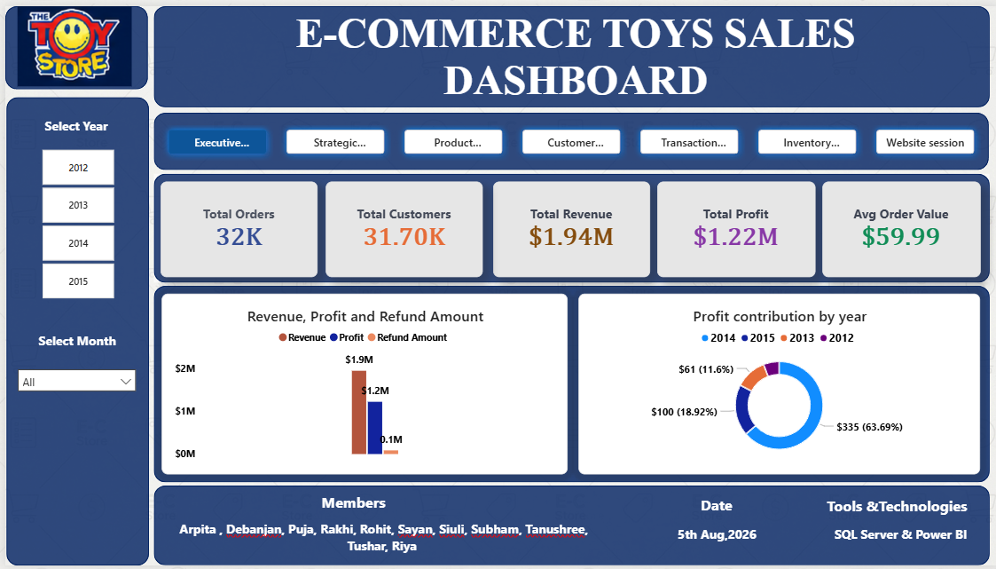
5.1 Executive Summary
Landing page of the report: total revenue, profit, orders, customers, AOV and refunds for the selected period, alongside the dashboard cover and project credits.

Slide 10
5.1 Executive Summary
Landing page of the report: total revenue, profit, orders, customers, AOV and refunds for the selected period, alongside the dashboard cover and project credits.
1
$1.22M profit on $1.94M revenue implies low relative COGS or premium pricing: a very strong margin for e-commerce retail.
2
Refunds sit near $0.1M against $1.94M in revenue. Roughly 5%. Returns are not a risk as of today.
3
2014 alone generated 63.69% of all profit, with 2013 a distant second at 18.92%.

Slide 11
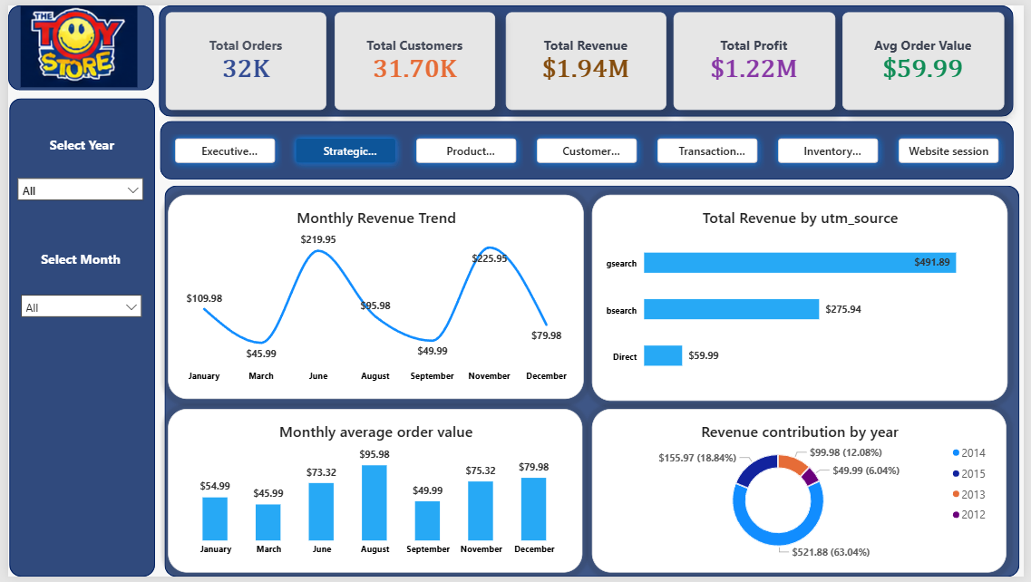
5.2 Strategic Takeaways
Alternate/continuation view adding a revenue trend line and revenue-by-traffic-source breakdown to the core KPI cards.

Slide 12
5.2 Strategic Takeaways
Alternate/continuation view adding a revenue trend line and revenue-by-traffic-source breakdown to the core KPI cards.
1
Monthly Revenue peaks significantly in June ($219.95) and November ($225.95). Drops to its lowest points in March ($45.99) and September ($49.99), finishing at $79.98 in December.
2
Google search (gsearch) drives $491.89 in revenue which is more than bsearch ($275.94) and Direct ($59.99) combined which is confirming Google search is the primary source growth.
3
Monthly average order value peaks in August ($95.98) even though revenue that month is mid-range that means customers buy less often but spend more per order.
4
Revenue contribution in 2012 (18.84%), 2013 (12.08%), and 2015 (6.04%) trail well behind 2014(63.04%) the same concentration pattern seen in the Executive profit-by-year view.

Slide 13
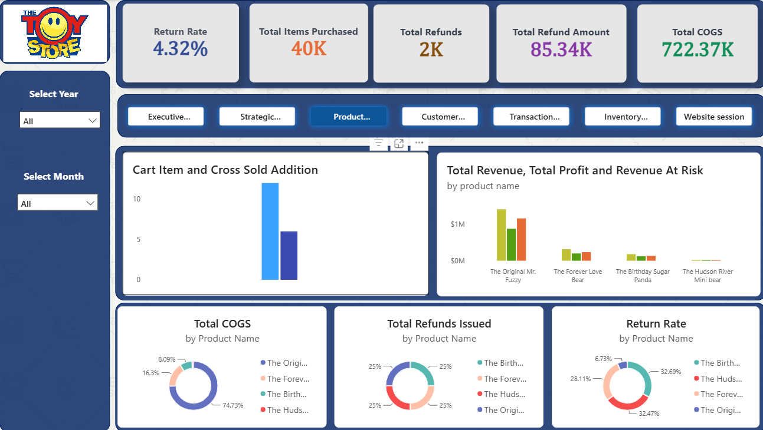
5.3 Product Analysis
Which products drive revenue and profit, which are returned/refunded most, cost of goods sold, and cross-sell behaviour.

Slide 14
5.3 Product Analysis
Which products drive revenue and profit, which are returned/refunded most, cost of goods sold, and cross-sell behaviour.
There is a very high cross-sell conversion. Customers are very receptive to cross-sell recommendations. For every 2 primary items added to a cart, 1 additional recommended item is successfully added. There is an opportunity to attach cross-sells to lower-performing items like The Hudson River Mini Bear.
1
The Original Mr. Fuzzy dominates overall revenue, profit, and potential revenue at risk (above $1M). The remaining three products generate significantly lower financial volume, with The Hudson River Mini Bear contributing minimal revenue and profit.
2
3
The vast majority of production/inventory costs belong to the top-selling product (The Original Mr. Fuzzy). The secondary products, matching their proportion of overall sales volume.
4
Refunds are evenly split across all four products (25% each), indicating that total refund count is uniform regardless of sales volume differences.
5
More than 90% of the total returns are of the low performing products.

Slide 15

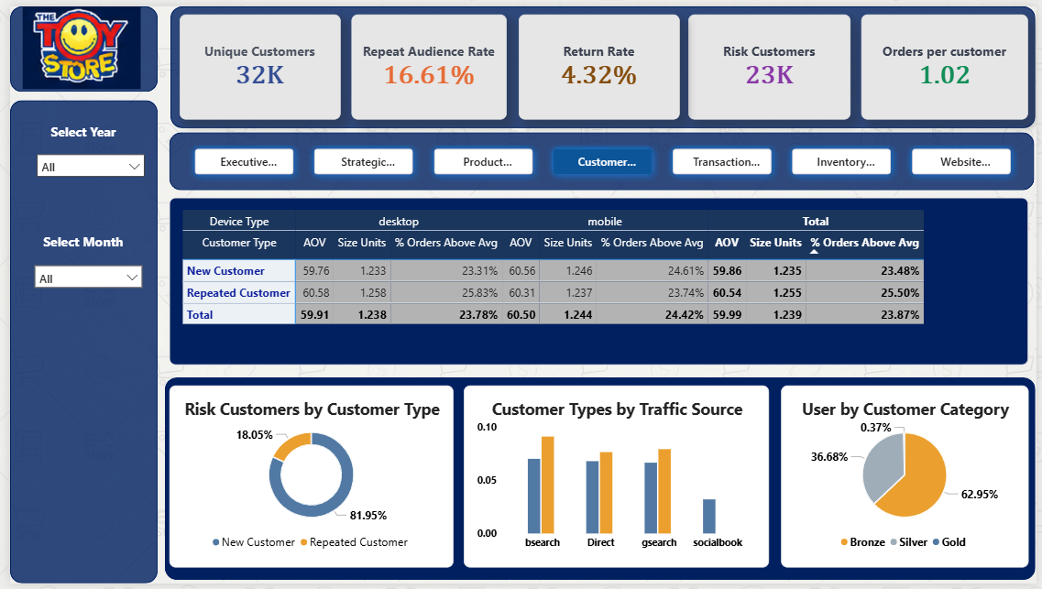
5.4 Customer Behaviour
Segments the customer base — new vs. repeat, at-risk vs. active, device type — with basket size and AOV by segment.

Slide 16
5.4 Customer Behaviour
Segments the customer base — new vs. repeat, at-risk vs. active, device type — with basket size and AOV by segment.
1
Average Order Value is extremely consistent across different customer segments.
2
First-time buyers present significantly higher retention or transaction risk than returning buyers.
3
bsearch, Direct, and gsearch attract a higher proportion of Repeated Customers compared to New Customers, socialbook exclusively drives New Customers with zero visible representation from returning customers.
More than 99% of the entire user base resides on entry or mid level tier. There is a strong transition of customers from bronze to silver tier, but transition to gold tier is very weak. Need to audit what it takes to reach to gold tier and revamp that if possible.
4

Slide 17
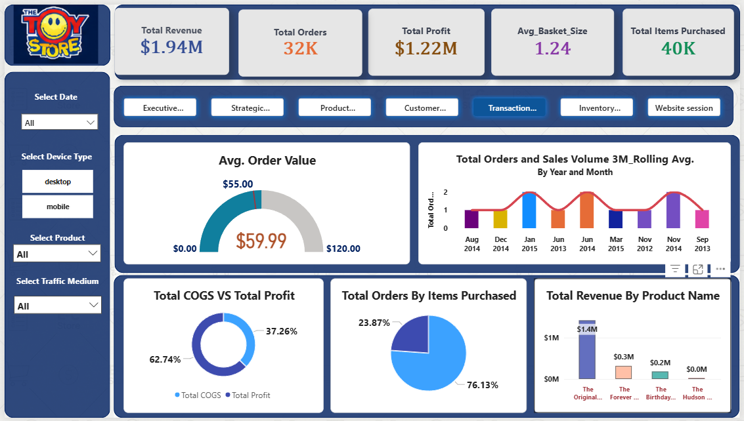
5.5 Transaction Analytics
Order-level detail: revenue/profit trends, AOV gauge, rolling 3-month sales volume, basket size, revenue by product.

Slide 18
5.5 Transaction Analytics
Order-level detail: revenue/profit trends, AOV gauge, rolling 3-month sales volume, basket size, revenue by product.
1
The current AOV sits at $59.99. A target threshold line is marked around $55.00, meaning current average spending is beating the baseline target by roughly $5.00.
Order volume reaches its highest points (2 orders) in Jan 2015, Jun 2014, and Nov 2014. This drops to 1 order in periods like Aug 2014, Dec 2014, Jun 2013, Mar 2015, Nov 2012, and Sep 2013. The wave pattern highlights strong recurring mid-year and year-end demand spikes.
2
3
Strong profit margins: the business retains over 62 cents of gross profit for every dollar generated. This indicates solid margins, providing comfortable room for paid marketing or promotional discounts.
4
Over three-quarters of all orders contain a single item, The Original Mr. Fuzzy. But only about a quarter of orders contain the other items.
5
The Original Mr. Fuzzy generates $1.4M, dominating overall business revenue. The Forever Love Bear generates $0.3M, The Birthday Sugar Panda generates $0.2M and The Hudson River Mini Bear gives a negligible contribution.

Slide 19
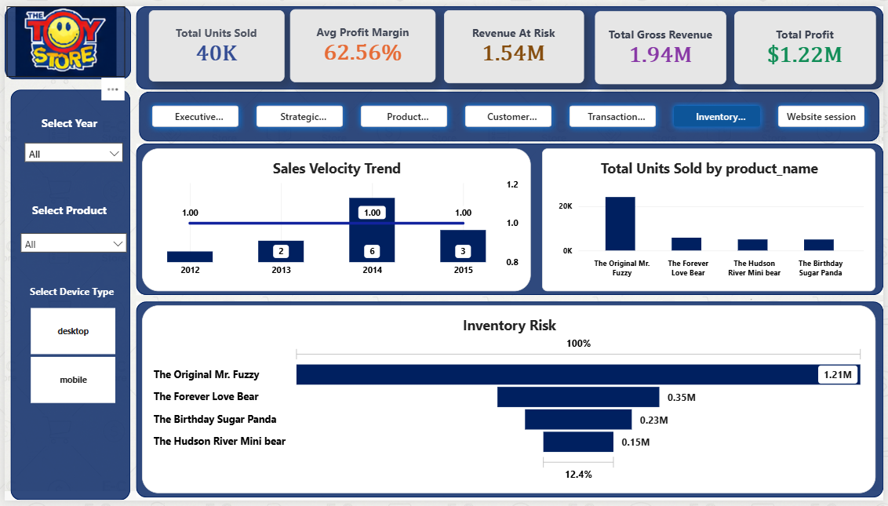
5.6 Inventory Analysis
Stock-relevant metrics: units sold, gross revenue, sales funnel, return rate, and revenue at risk from returns.

Slide 20
5.6 Inventory Analysis
Stock-relevant metrics: units sold, gross revenue, sales funnel, return rate, and revenue at risk from returns.
1
Sales velocity peaked in 2014 with 6 units/velocity score, up from 2 in 2013. The velocity dropped by half in 2015 down to 3, though remaining above 2012–2013 levels. The trendline holds steady at a benchmark of 1.00 across the period.
The Original Mr. Fuzzy dominates unit sales by a massive margin, exceeding 20,000 units, whereas The Forever Love Bear, The Hudson River Mini bear, and The Birthday Sugar Panda all cluster tightly at significantly lower volumes (roughly 2,000–4,000 units each).
2
The Original Mr. Fuzzy represents the vast majority of inventory risk value (1.21M), making overall business inventory health almost entirely tied to this single Stock Keeping Unit(SKU). Secondary SKUs range down to 0.15M (The Hudson River Mini bear), representing only 12.4% of top-tier exposure.
3
The Original Mr. Fuzzy drives 1.21M sessions, matching its dominance in sales and inventory footprint. Whereas The Forever Love Bear (0.35M sessions), The Birthday Sugar Panda (0.23M sessions), and The Hudson River Mini bear (0.15M sessions) capture far less top-of-funnel traffic.
4

Slide 21
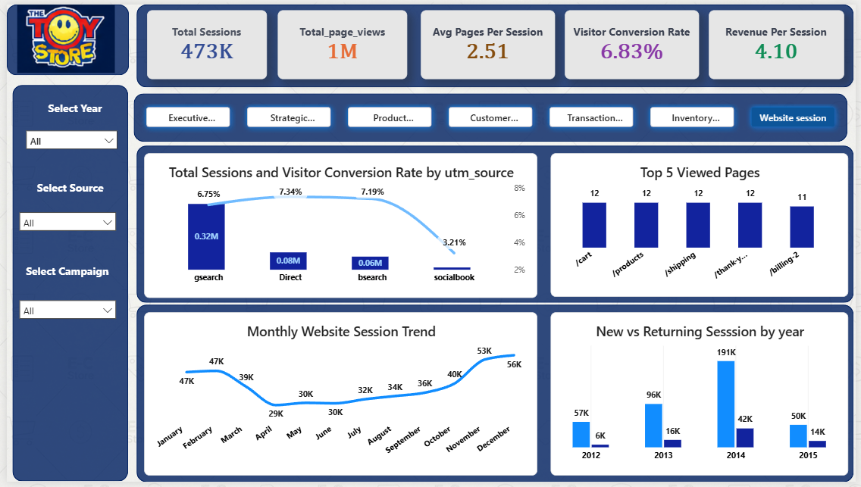
5.7 Website Session
Top-of-funnel web analytics: sessions, page views, conversion rate, pages/session, revenue per session.

Slide 22
5.7 Website Session
Top-of-funnel web analytics: sessions, page views, conversion rate, pages/session, revenue per session.
1
gsearch dominates traffic volume at 0.32M sessions with a strong 6.75% conversion rate. Direct Traffic generates 0.08M sessions with the highest conversion rate at 7.34% and bsearch delivers 0.06M sessions with a strong 7.19% conversion rate. Socialbook drives minimal traffic with the lowest conversion rate at 3.21% (less than half of the search/direct channels).
2
cart (12), products (12), shipping (12), and thank-you (12) share equal top pageviews, followed by billing (11). This indicates high-intent traffic progressing evenly through the core checkout path.
Website view begins strong in January (47K) and February (47K), before dipping through March (39K). This hits its lowest point in April (29K), followed by a slow recovery through May (30K), June (30K), and July (32K). Traffic accelerates steadily through autumn, August (34K), September (36K), October (40K) and peaks during the year end holiday shopping season in November (53K) and December (56K).
3
Total traffic peaked massively in 2014, reaching 191K new sessions and 42K returning sessions. Traffic dropped substantially in 2015 to 50K new sessions and 14K returning sessions. Across all years, new user sessions make up roughly 75-90% of total web traffic, highlighting a heavily acquisition-driven funnel.
4

Slide 23
6. Filters & Interactivity
Date (Month / Year)
Device Type
Executive Summary, Strategic Takeaways, Product Analysis, Customer Behaviour, Inventory Analysis, Website Session
Transaction Analytics, Inventory Analysis
Product
Traffic Source / Medium
Transaction Analytics, Inventory Analysis
Strategic Takeaways, Customer Behaviour, Transaction Analytics, Website Session
Campaign
Page Navigator
Website Session
Click-through buttons on every one of the 7 pages

Slide 24

Thank You!

